Slide 1

Exploratory Data Analysis
Project Cab Investment
Dated: 20-12-2022

Slide 2

Agenda
Background:
US-based private company XYZ is considering investing in the taxi business as a result of the industry's impressive recent expansion but due to the presence of numerous significant players and tough market conditions they first want to fully comprehend the market.
Problem Statement:
Analysis needs to be done, for the recommendation of the expected profitable Cab company to invest in.
Analysis Division:
Data Interpretation
Comparison tests between Yellow Cab and Pink Cab
Hypothesis Testing
Recommendation

Slide 3
Data Interpretation
The master data was created by the combination of 4 datasets, contained in csv files, timeframe from 2016-01-31 to 2018-12-31:
Cab Data
Customer Data
City Data
Transaction
Master Data
Cab Data
City Data
Customers Data
Transactions Data

Slide 4
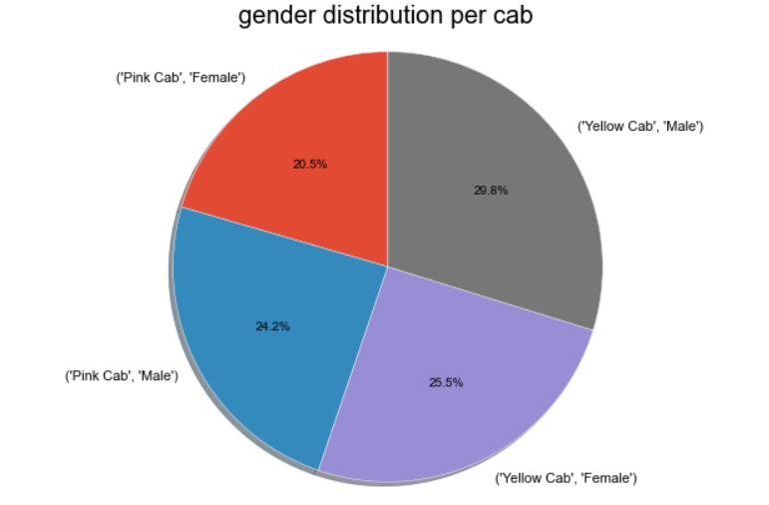
Comparison Tests
It can be seen that both male and female tends to prefer Yellow cab over Pink cab.

Slide 5
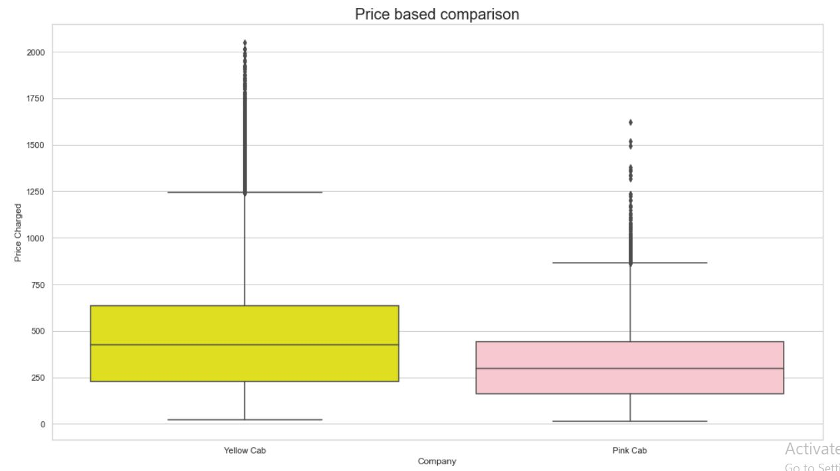
Comparison Tests
Yellow cab charges more than Pink Cab.

Slide 6
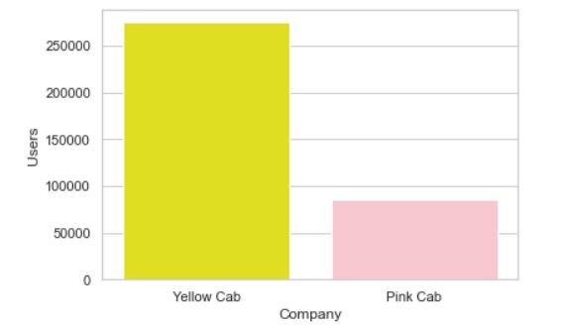
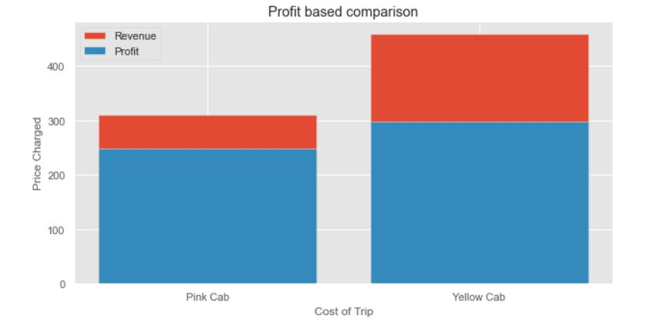
Comparison Tests
User based Comparison
Yellow cab has 3x more users then Pink cab.
Yellow cab generates more revenue and profit as compared to pink cab.

Slide 7
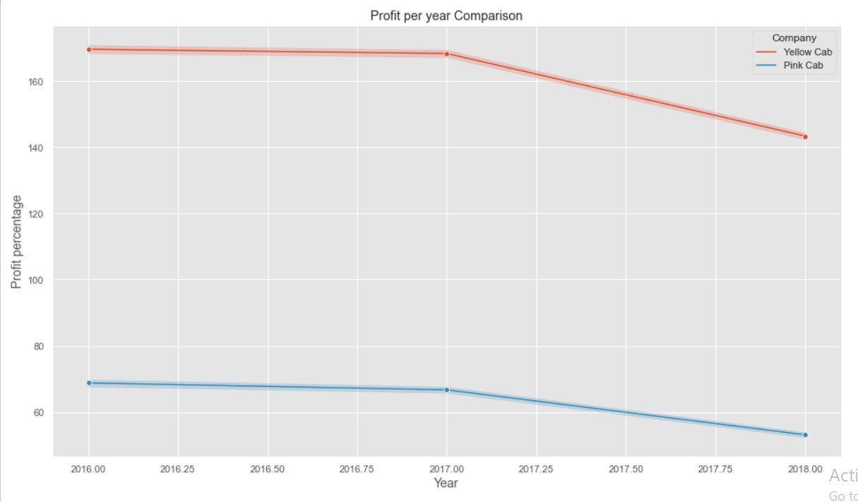
Comparison Tests
Over the period of 3 years, profit of both companies have declined. However, Yellow cab has shown way more profit than pink cab at any point of time.

Slide 8
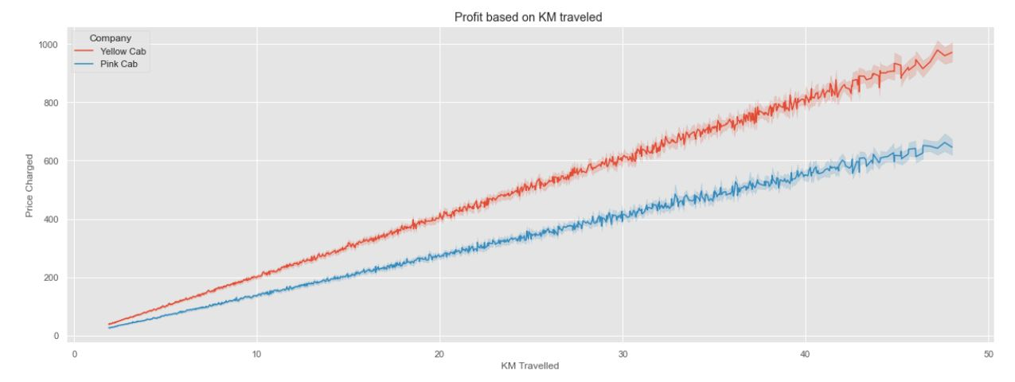
Comparison Tests
On the basis of distance travelled, Yellow cab is again leading the profit.

Slide 9
Hypothesis Testing
Hypothesis Test 1
Ho= price charges does not impact on profit
H1= price charges have impact on profit
We accept alternative hypothesis (H1) that price charges have impact on profit
Hypothesis Test 2
H0 : There is no difference regarding Gender for both cab companies.
H1 : There is difference regarding Gender for both cab companies.
We accept null hypothesis (H0) that there is no difference regarding gender for Pink Cab

Slide 10
Recommendations
As per the EDA performed on the data provided, Yellow cab has performed better in all the comparison tests.
Hence, it is recommended to investment in Yellow Cab.

Slide 11
Thank You

